Slide 1
Accessing Public Data

Slide 2
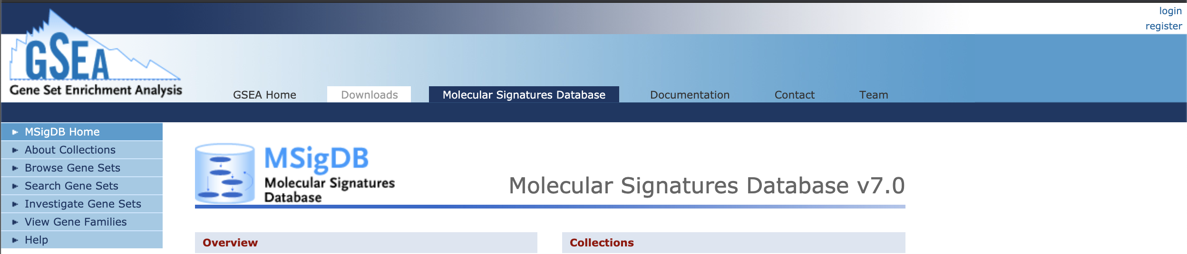
The Molecular Signatures Database (MSigDB)
Repository for gene signatures and gene sets.
Useful for gene set enrichment analysis (GSEA), pathway analysis, and statistical overrepresentation analysis.
A valid email address is required to download gene sets.
https://www.gsea-msigdb.org/gsea/msigdb/index.jsp

Slide 3
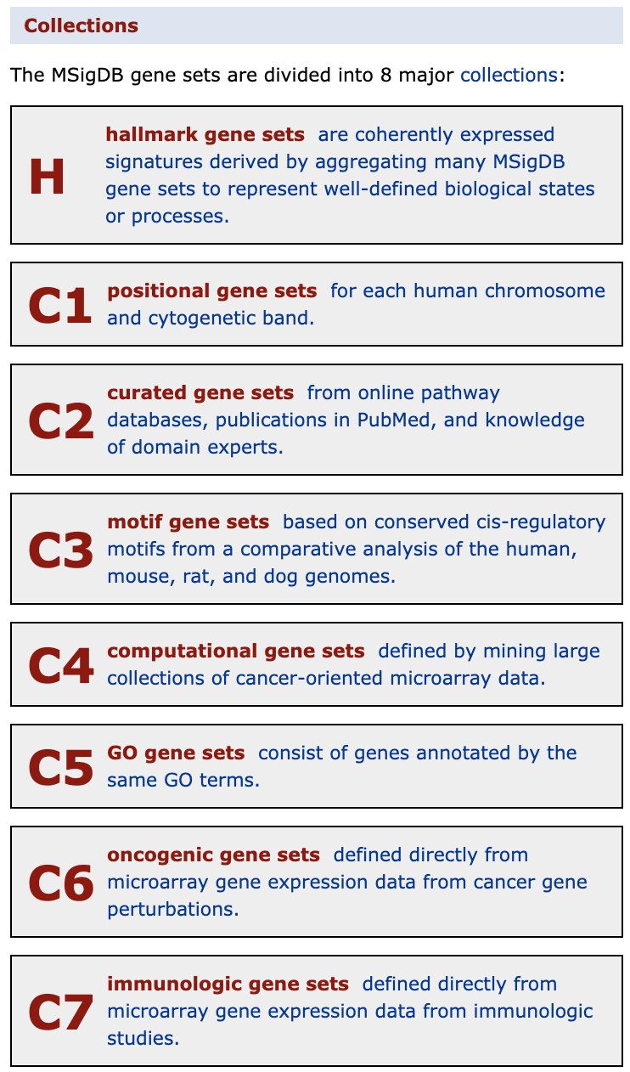
MSigDB
There are multiple collections of gene sets.
The Hallmark gene set is frequently used, but there are many others.

Slide 4
Panther GO
Website for performing gene ontology analysis, and others.
There are many organism to choose from.
Great for producing GO pie charts and statistical overrepresentation results.
Start from a list of genes that are either up or down regulated. Do not use all genes.
http://www.pantherdb.org
Mi, Huaiyu, et al. "PANTHER version 14: more genomes, a new PANTHER GO-slim and improvements in enrichment analysis tools." Nucleic acids research 47.D1 (2019): D419-D426.

Slide 5
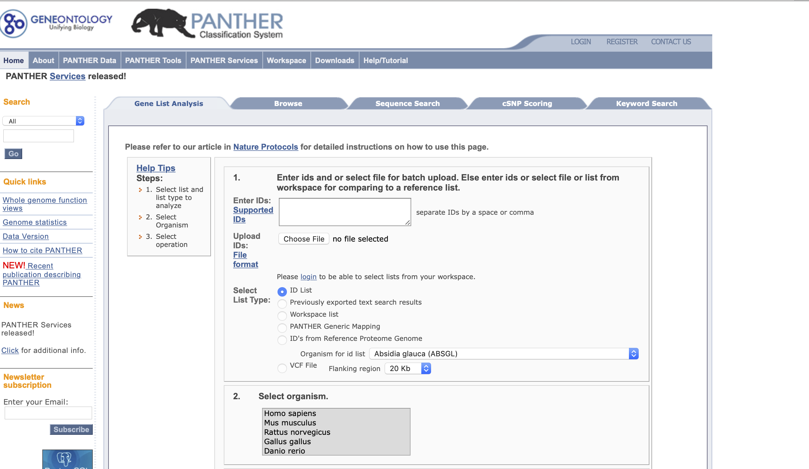
Step1:
Copy/paste or upload list of gene names
Step2:
Select species
Cont. for step 3 ->

Slide 6
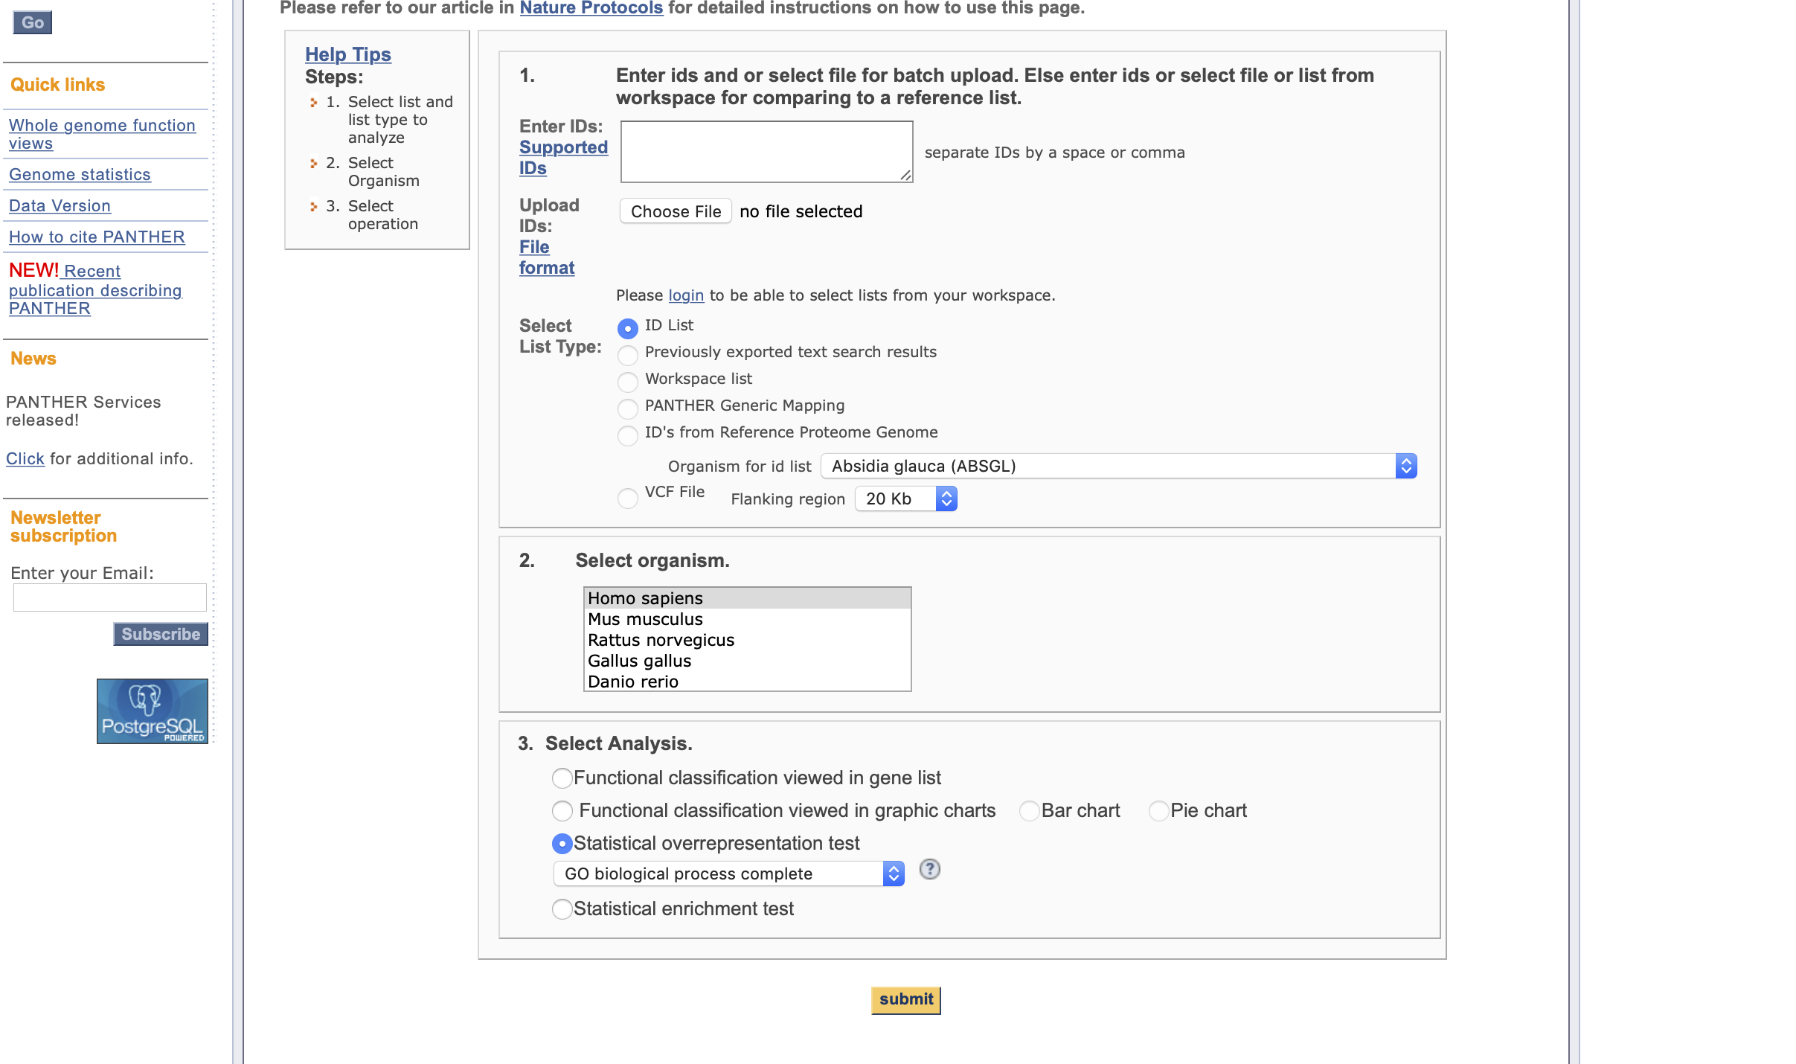
Step3:
Select “Statistical overrepresentation test” and “GO biological process complete, then “submit”

Slide 7
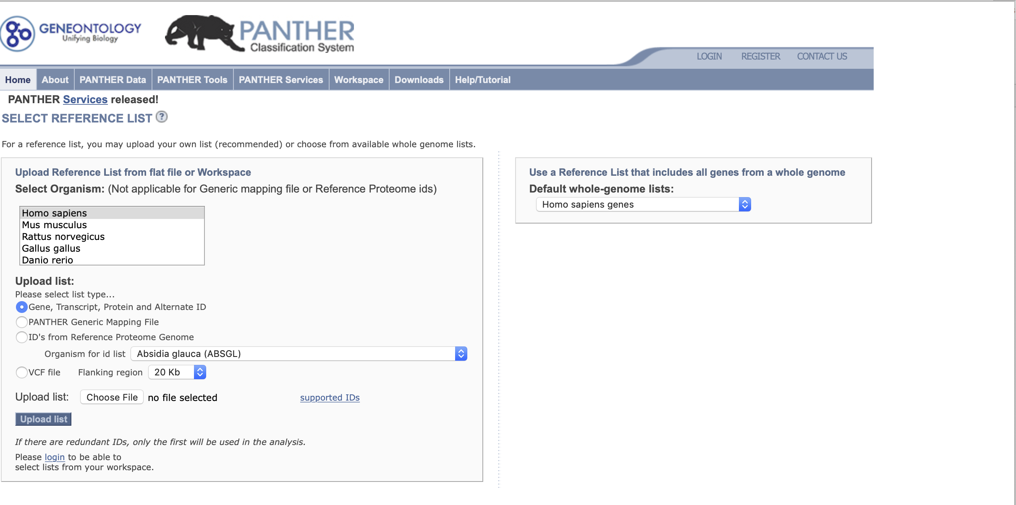
Step 4:
Choose the species list you want.

Slide 8
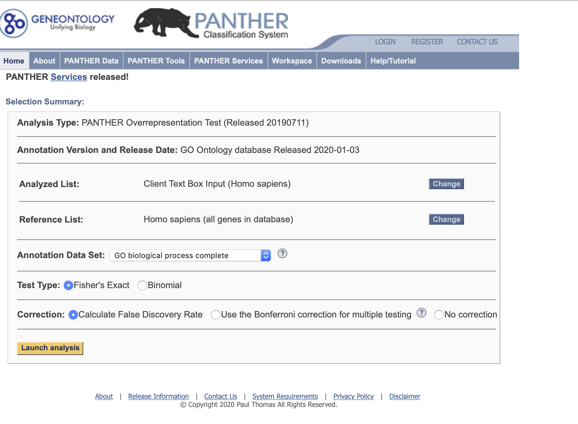
Step 5:
Make sure everything is correct on this page and then click “Launch analysis”

Slide 9
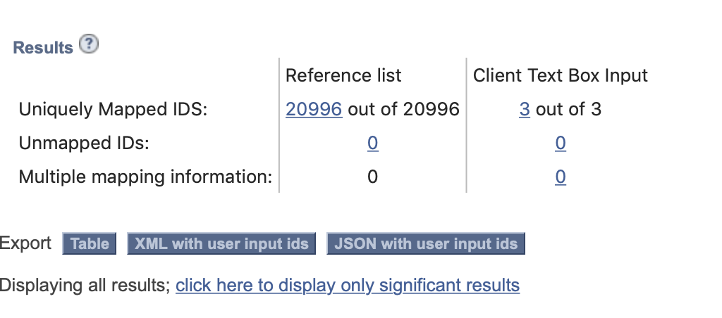
Here’s an example of the results header.
You can select for all genes, or only significant results.
The resulting table can be downloaded but it is better to view in the webpage.
See Panther website for more helpful tutorials.

Slide 10
Submitting Data to the Gene Expression Omnibus (GEO)
Repository for NGS data.
Most journals require data to be submitted before publishing, or even before being sent to reviewers.
So how to do it?

Slide 11
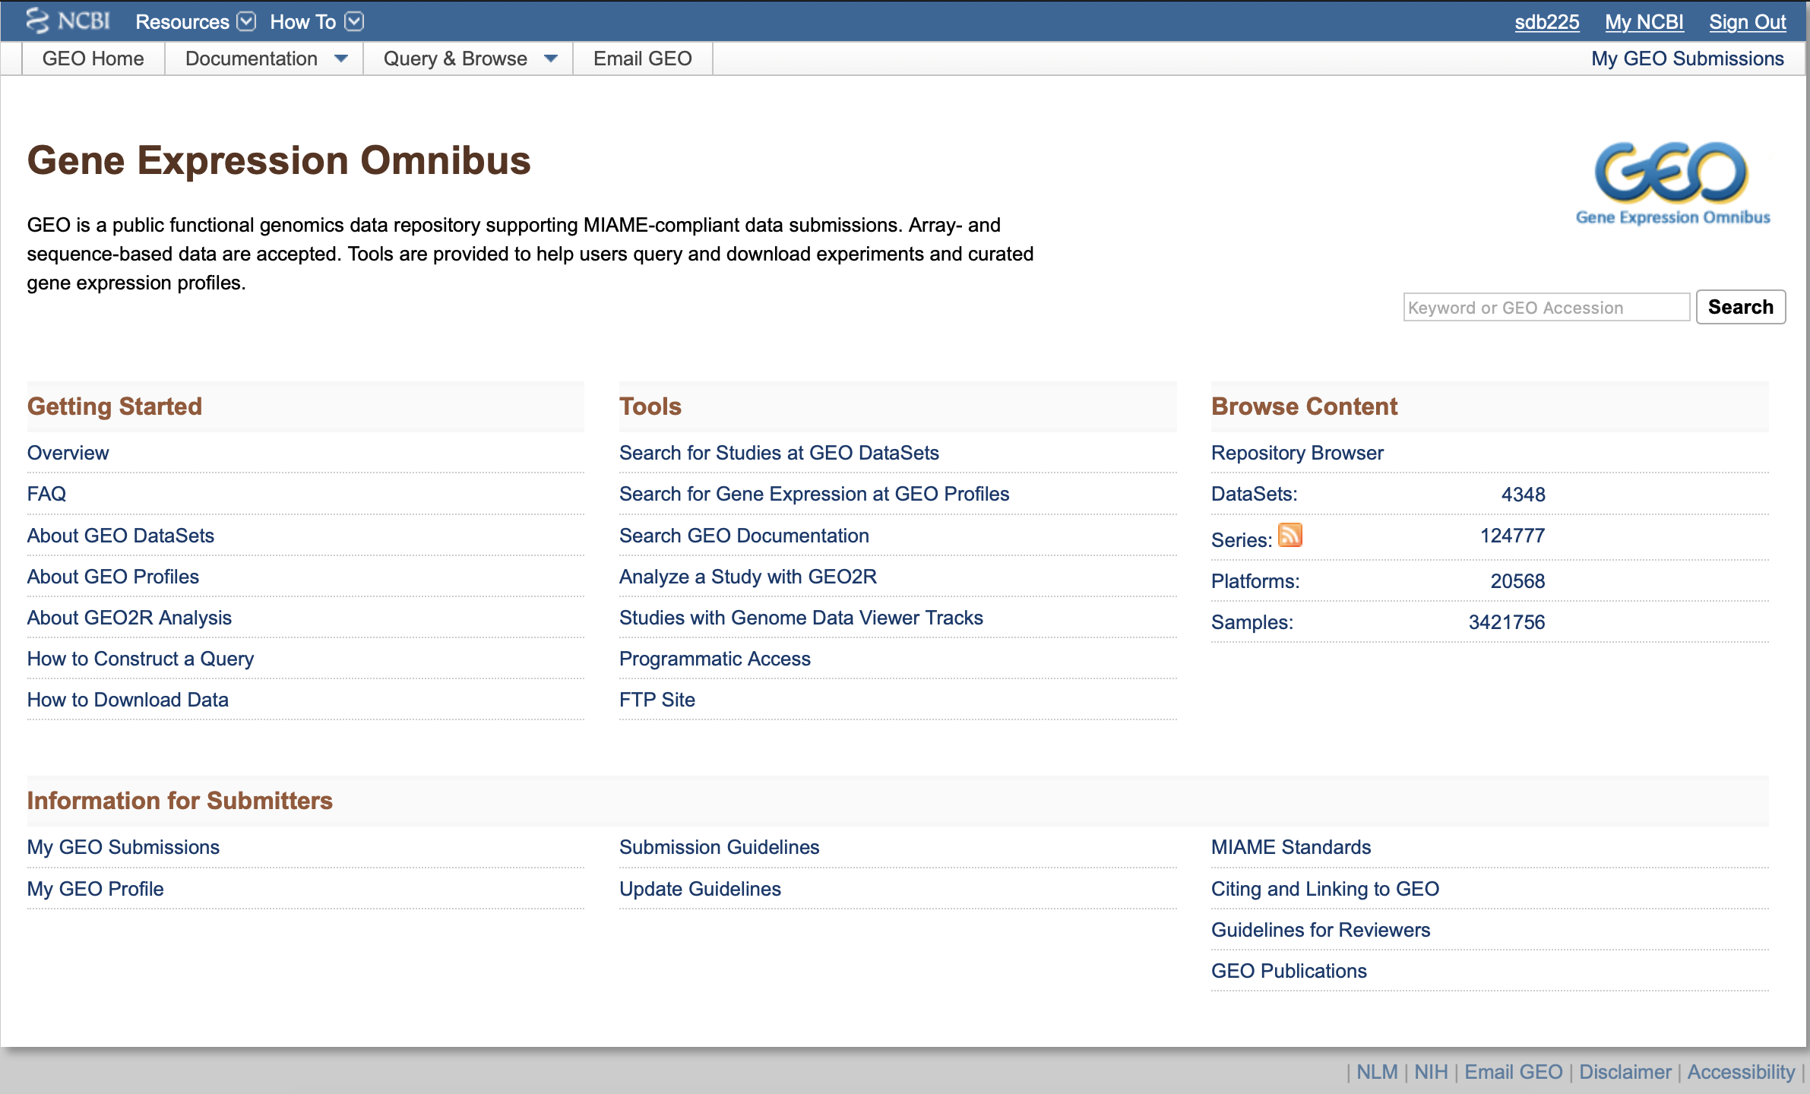
Notes:
Always always read the submission guidelines for the type of data you wish to submit.

Slide 12
Things you will need
A GEO/NCBI account.
Raw data(ie fastq files)
Processed data files (eg countTables or bigwig, but NOT bam files)
MD5 checksum
GEO metadata spreadsheet.
Notes:
Checksum basically like a barcode. Changing anything in the contents of the file will change the checksum, so useful to check it before and after downloading.

Slide 13
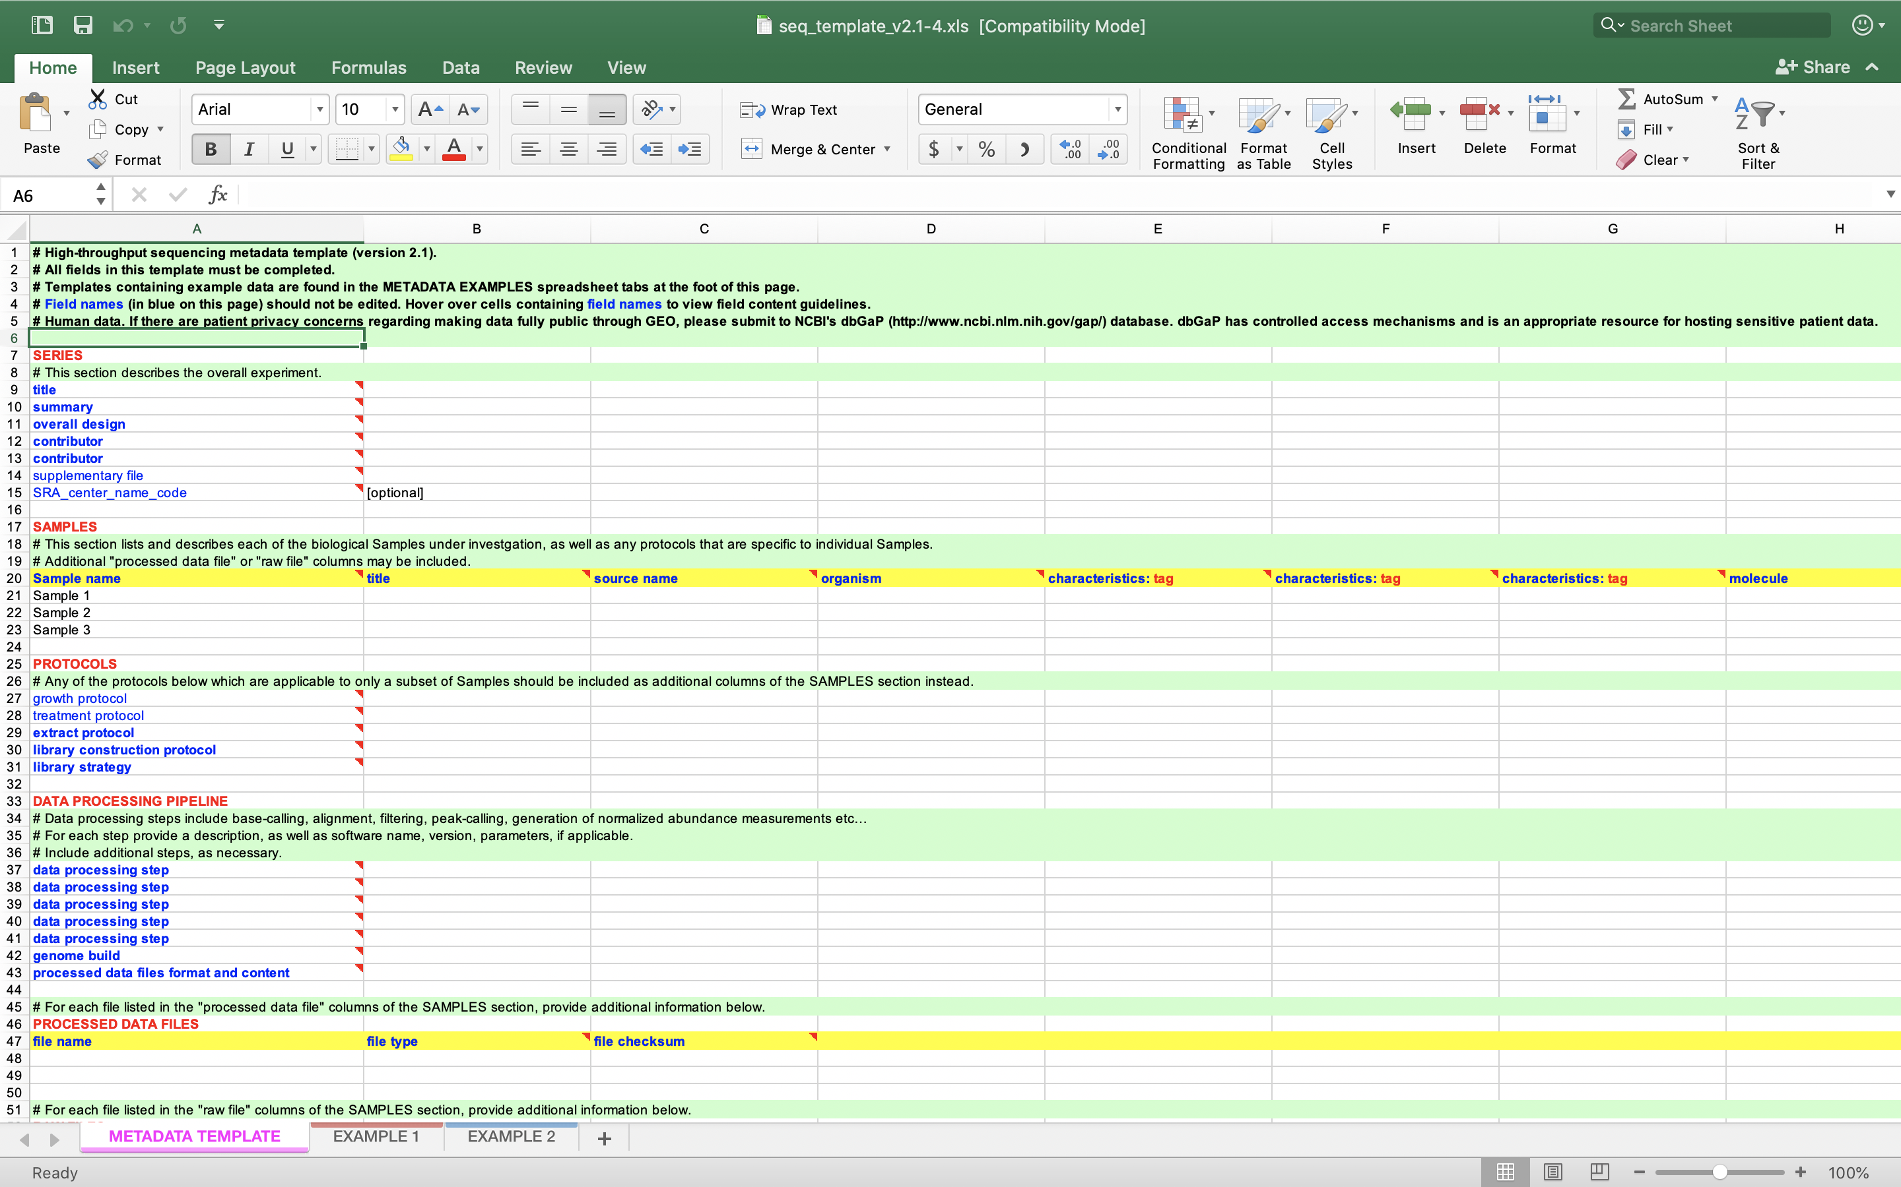

Slide 14
Things you will need
Place all files in a single folder. Name the folder something like “your_geo_username_rnaseq”.
Notes:
Checksum basically like a barcode. Changing anything in the contents of the file will change the checksum, so useful to check it before and after downloading.

Slide 15
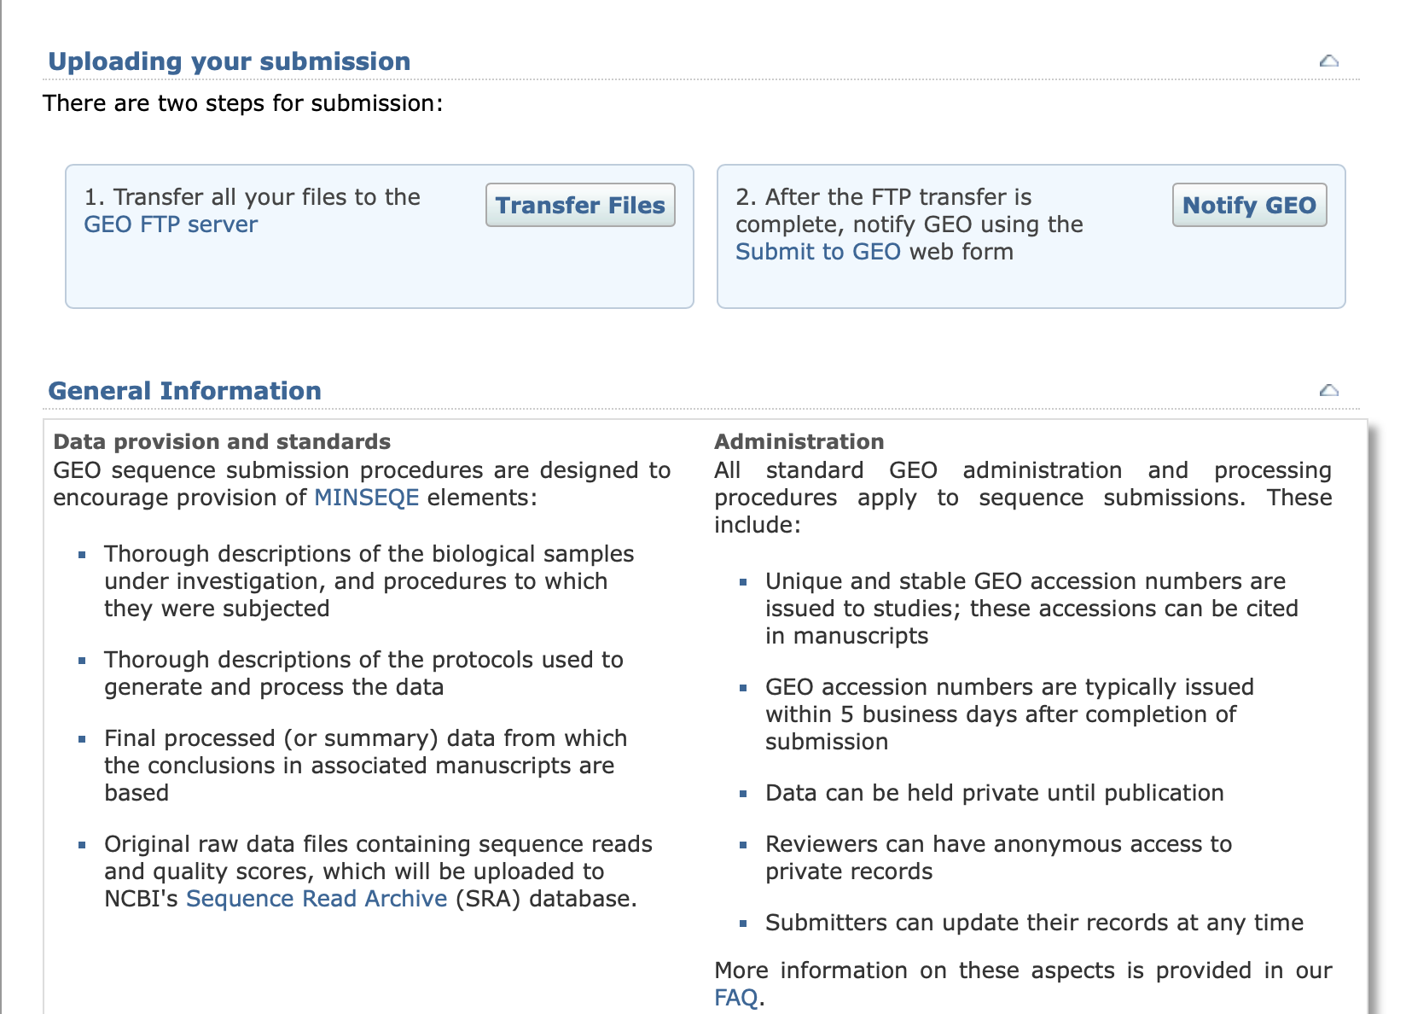

Slide 16
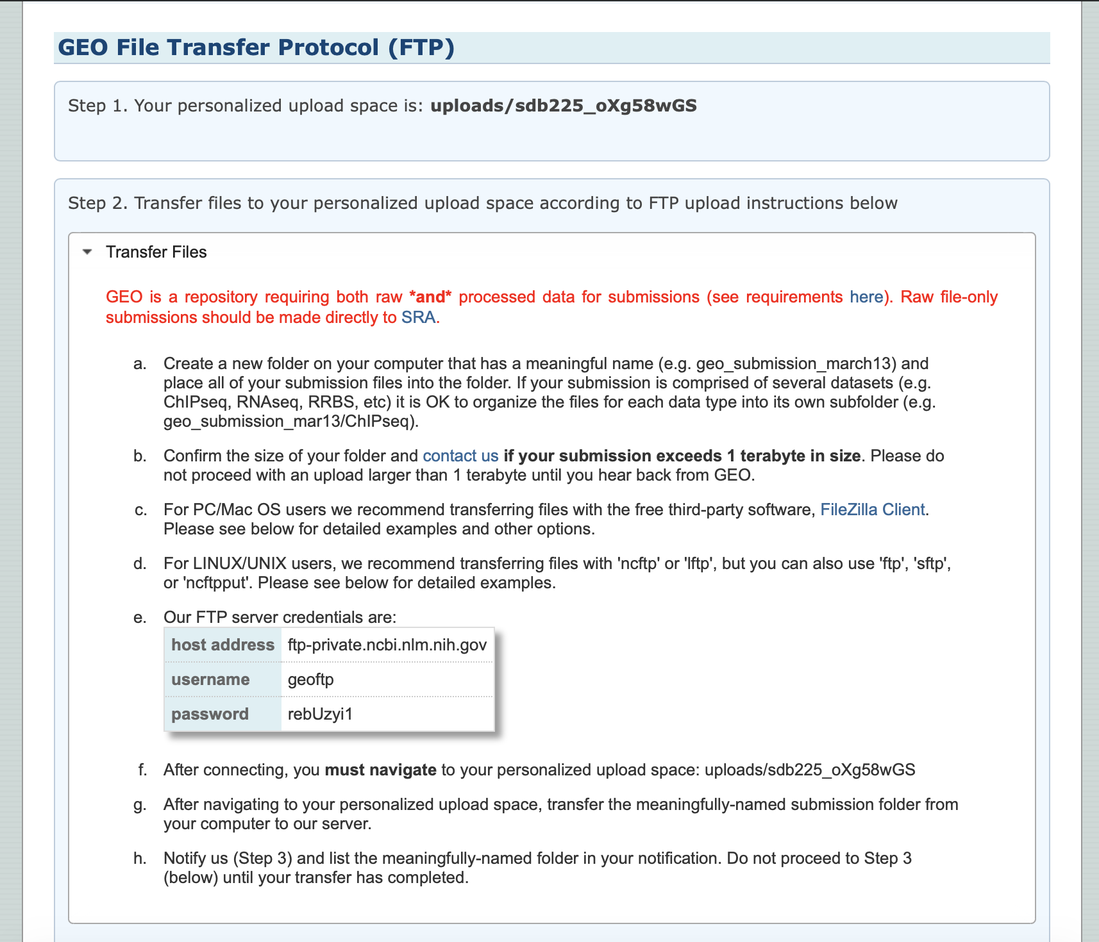

Slide 17
